Slide 1
ME 609
Optimization Methods in Engineering
Programming Project - Phase 3
Optimization of Multivariable Constraint Problems
using Bracket Operator Penalty Method
Done by
Akshath Krishna R (210103012)
Joel Joseph A(210103060)

Slide 2
Description of Method
Goal: Minimize objective functions under constraints.
Methods Used:
Penalty Function Method: Converts constrained optimization problems to unconstrained by adding penalty terms. Penalty multiplier 𝑟 increases in each iteration, enforcing constraint satisfaction.
Powell's Direction Method: Finds minimum along sequential directions, updating directions after each step for efficient multi-dimensional convergence.
Bounding Phase and Golden Section Search: Bounding phase defines an interval for linear search. Golden Section Search refines solution by narrowing the interval until convergence.
Bracket Operator Method: Manages the outer loop, progressively increasing 𝑟 for stricter constraint enforcement. Iterates until the difference in penalty values meets a tolerance criterion.

Slide 3
Flowchart of Algorithm
Input: Problem number (index) and Random seed
Define bounds based on problem number
Run the Bracket Operator Method with Powell's Direction Method
Generate random initial points within bounds
Run linear search and update directions
Calculate penalty and objective function values
Output optimized point and objective function value
Check if optimal point is reached or max iterations

Slide 4
Parameter Settings for the Optimization Algorithm
Initial Penalty Factor (r0​):
Purpose: Balances the objective function and penalty terms initially.
Typical Value: r0 = 0.1.
Penalty Growth Factor (c):
Purpose: Increases r after each iteration to enforce stricter constraint handling.
Typical Value: c = 12.
Tolerance (ε):
Purpose: Determines convergence precision for stopping criteria.
Typical Value: ε=1×10−4(adjusts convergence accuracy).
Maximum Iterations (for Bracket Operator):
Purpose: Prevents infinite loops by setting an upper bound on iterations.
Typical Value: 1000 iterations.
Line Search Parameters:
Direction Step Size (δ) in Bounding Phase: δ=0.15.
Golden Section Ratio (ϕ): ϕ=0.618 for optimal interval reduction.

Slide 5
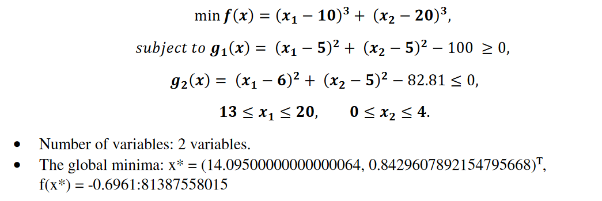
Results
SNo. | Function evaluation
 | x₀ | x_opt | _{f(x)} | Evaluations
1 | {18.5758, 0.733739} | {14.095, 0.842967} | -6961.81 | 447954
2 | {18.4578, 2.3874} | {14.095, 0.842966} | -6961.81 | 447690
3 | {16.1208, 0.3999} | {14.095, 0.84297} | -6961.8 | 447663
4 | {16.2147, 1.33483} | {14.095, 0.842968} | -6961.81 | 447401
5 | {14.0001, 2.60355} | {14.095, 0.842965} | -6961.81 | 447394
6 | {13.3949, 2.888} | {14.095, 0.84297} | -6961.8 | 447334
7 | {19.5699,0.0031156} | {14.095, 0.842969} | -6961.81 | 448506
8 | {19.9455, 2.46993} | {14.095, 0.842964} | -6961.81 | 448572
9 | {17.2816, 0.0282652} | {14.095, 0.842969} | -6961.8 | 448029
10 | {13.1614, 2.0991} | {14.095, 0.842965} | -6961.81 | 447248
Best: -6961.81
Worst: -6961.8
Mean: -6961.807
Median: --6961.81
Standard Deviation:0.0045825756950559

Slide 6
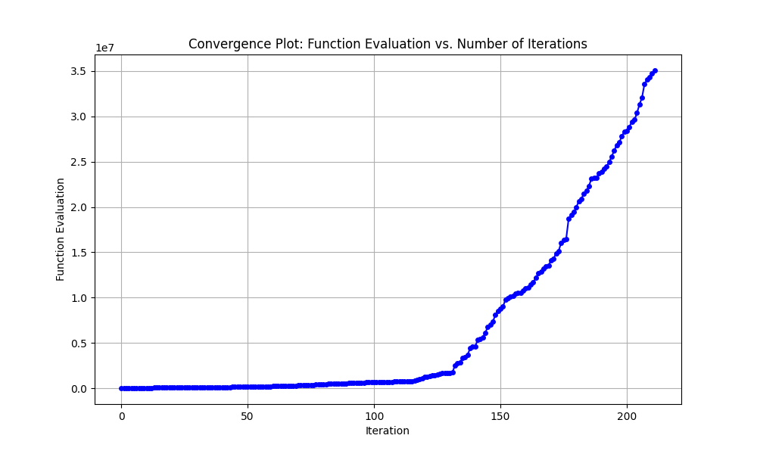

Slide 7
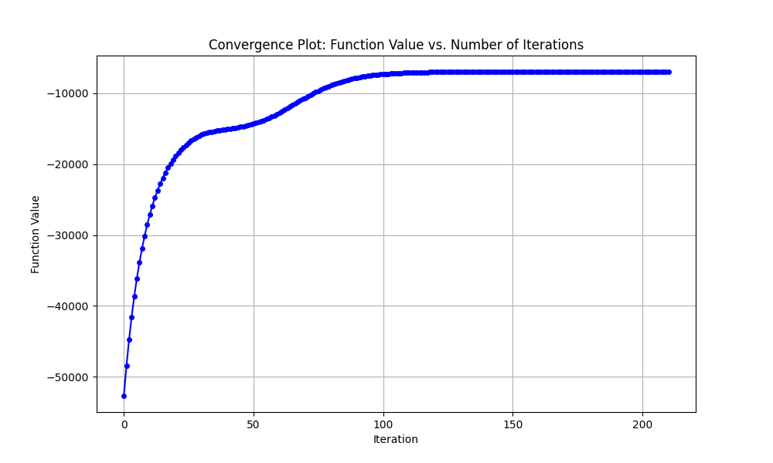

Slide 8
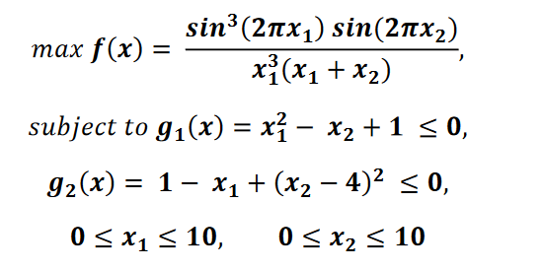
Results
SNo. | Function evaluation
 | x₀ | x_opt | _{f(x)} | Evaluations
1 | {7.96543, 1.83435} | {1.22782, 3.74491} | -0.10546 | 3318
2 | {7.79691, 5.9685} | {1.73403, 4.24577} | -0.0315806 | 3518
3 | {4.45833, 0.999749} | {1.73403, 4.24577} | -0.0315806 | 1120
4 | {4.59249, 3.33709} | {1.56016, 3.43406} | -0.00106705 | 3090
5 | {1.42867, 6.50888} | {2,5} | 1.70208e-23 | 2192
6 | {0.564116, 7.21999} | {1.73403, 4.24576} | -0.0315806 | 2233
7 | {9.38553,0.00778765} | {2,5} | 1.3173e-26 | 1782
8 | {9.92212, 6.17482} | {1.22782, 3.74491} | -0.10546 | 4645
9 | {6.11653, 0.0706631} | {1.73403, 4.24577} | -0.0315806 | 684
10 | {0.230624, 5.24775} | {2,5} | 1.67202e-25 | 3316
2.
Number of variables: 2 variables.
• The global minima: x* = (1.227, 4.245)T , f (x*) = 0.0958.
Best: 1.70208e-23
Worst: -0.10546
Mean: -0.033830945
Median: -0.0315806
Standard Deviation: 0.038456170616966

Slide 9
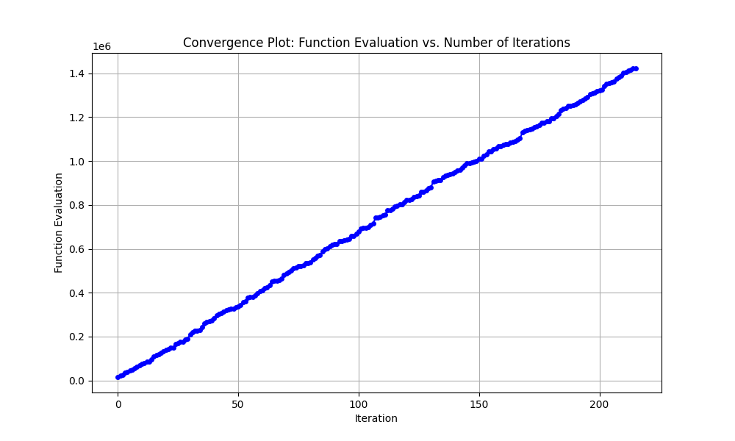

Slide 10
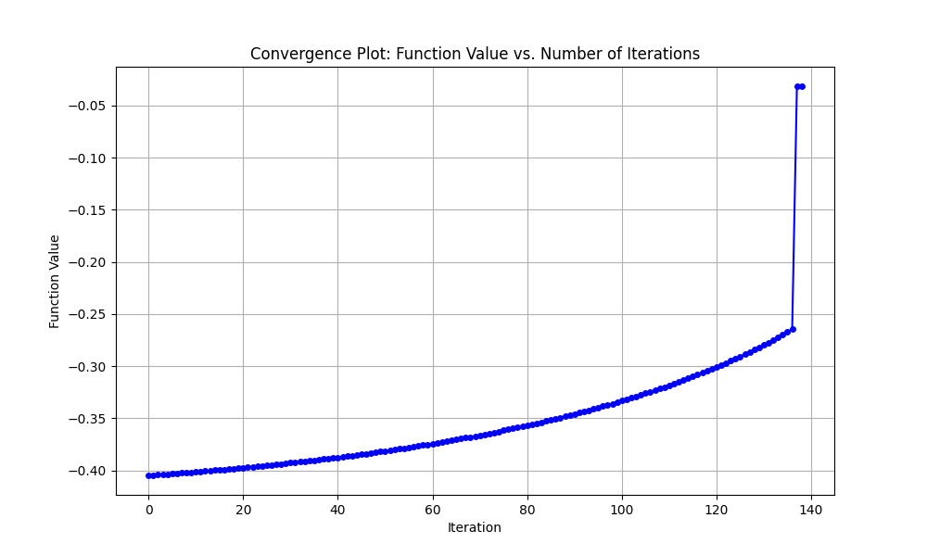

Slide 11
Conclusion
As the value of c increases, the number of function call decreases and vice-versa.
A higher r accelerates the convergence but may lead to less accurate solutions and a lower r results in slower convergence, but it often improves the accuracy of the final solution by balancing the objective and penalty terms more effectively.
Starting points closer to the true optimum result in faster convergence and fewer evaluations.
A smaller ε improves the precision of the solution but increases the number of iterations and a larger ε leads to faster convergence but may result in suboptimal solutions.

Slide 12
Thank You

